Slide 1
ID3 Algorithm
Courtesy Allan Neymark

Slide 2
Decision Trees
Rules for classifying data using attributes.
The tree consists of decision nodes and leaf nodes.
A decision node has two or more branches, each representing values for the attribute tested.
A leaf node attribute produces a homogeneous result (all in one class), which does not require additional classification testing.

Slide 3



Decision Tree Example
Outlook
sunny
overcast
rain
Humidity
Yes
Windy
high
normal
true
false
No
Yes
No
Yes

Slide 4
What is ID3?
A mathematical algorithm for building the decision tree.
Invented by J. Ross Quinlan in 1979.
Uses Information Theory invented by Shannon in 1948.
Builds the tree from the top down, with no backtracking.
Information Gain is used to select the most useful attribute for classification.

Slide 5
Example: The Simpsons

Slide 6










Person | Hair Length | Weight | Age | Class
Homer | 0” | 250 | 36 | M
Marge | 10” | 150 | 34 | F
Bart | 2” | 90 | 10 | M
Lisa | 6” | 78 | 8 | F
Maggie | 4” | 20 | 1 | F
Abe | 1” | 170 | 70 | M
Selma | 8” | 160 | 41 | F
Otto | 10” | 180 | 38 | M
Krusty | 6” | 200 | 45 | M
Comic | 8” | 290 | 38 | ?

Slide 7
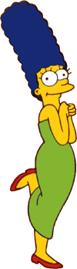


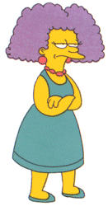
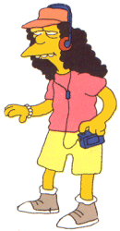
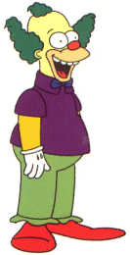
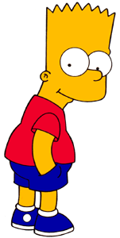


Entropy(4F,5M) = -(4/9)log₂(4/9) - (5/9)log₂(5/9)
= 0.9911
yes
no
Hair Length <= 5?
Let us try splitting on Hair length
Entropy(1F,3M) = -(1/4)log₂(1/4) - (3/4)log₂(3/4)
= 0.8113
Entropy(3F,2M) = -(3/5)log₂(3/5) - (2/5)log₂(2/5)
= 0.9710
Gain(Hair Length <= 5) = 0.9911 – (4/9 * 0.8113 + 5/9 * 0.9710 ) = 0.0911

Slide 8
Entropy(4F,5M) = -(4/9)log₂(4/9) - (5/9)log₂(5/9)
= 0.9911
yes
no
Weight <= 160?
Let us try splitting on Weight
Entropy(4F,1M) = -(4/5)log₂(4/5) - (1/5)log₂(1/5)
= 0.7219
Entropy(0F,4M) = -(0/4)log₂(0/4) - (4/4)log₂(4/4)
= 0
Gain(Weight <= 160) = 0.9911 – (5/9 * 0.7219 + 4/9 * 0 ) = 0.5900

Slide 9
Entropy(4F,5M) = -(4/9)log₂(4/9) - (5/9)log₂(5/9)
= 0.9911
yes
no
age <= 40?
Let us try splitting on Age
Entropy(3F,3M) = -(3/6)log₂(3/6) - (3/6)log₂(3/6)
= 1
Entropy(1F,2M) = -(1/3)log₂(1/3) - (2/3)log₂(2/3)
= 0.9183
Gain(Age <= 40) = 0.9911 – (6/9 * 1 + 3/9 * 0.9183 ) = 0.0183

Slide 10
Of the 3 features we had, Weight was best. But while people who weigh over 160 are perfectly classified (as males), the under 160 people are not perfectly classified… So we simply recurse!
yes
no
Weight <= 160?
This time we find that we can split on Hair length, and we are done!
yes
no
Hair Length <= 2?

Slide 11
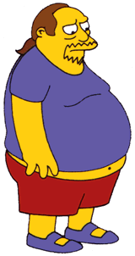
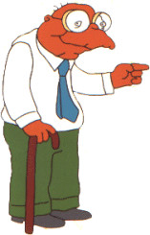

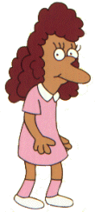
We need don’t need to keep the data around, just the test conditions.
Weight <= 160?
yes
no
How would these people be classified?
Hair Length <= 2?
Male
yes
no
Male
Female

Slide 12
It is trivial to convert Decision Trees to rules…
Weight <= 160?
yes
no
Hair Length <= 2?
Male
yes
no
Male
Female
Rules to Classify Males/Females
If Weight greater than 160, classify as Male
Elseif Hair Length less than or equal to 2, classify as Male
Else classify as Female

Slide 13
References
Quinlan, J.R. 1986, Machine Learning, 1, 81
http://dms.irb.hr/tutorial/tut_dtrees.php
http://www.dcs.napier.ac.uk/~peter/vldb/dm/node11.html
http://www2.cs.uregina.ca/~dbd/cs831/notes/ml/dtrees/4_dtrees2.html
Professor Sin-Min Lee, SJSU. http://cs.sjsu.edu/~lee/cs157b/cs157b.html

